Slide 1
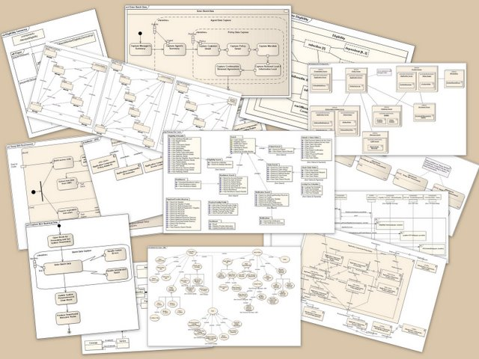

UML and ADT design plan
Poker

Slide 2
AGENDA
Please describe here how you design plan goes
You need to draw a full class diagram of your OOA design
For each class you need to describe a short ADT specification

Slide 3



Blackjack Class Diagram (EXAMPLE)
1
Dealer
name budget hand state strategy deck
shuffle()
1
Deck
cards
shuffle() draw_card()
0..52
Card
rank suit
value()
Game
dealer players log
open() close() run() history() is_finished()
0..52
Player
name budget hand state strategy
hit() stand()
0..1
Hand
cards soft
add(card) value()
2..6
log
1
state
Of course, you have to do a similar
Diagram for Poker …
string
1

Slide 4
Stack: Abstract Data Type
Interface
s = Stack() Constructor
  Create a new empty stack
s.push(item) Mutator
  Add an item to the top of the stack
s.pop() Mutator
  Pop an item from the top of the stack
s.peek() Accessor
  Return the item to the top of the stack (don’t pop it!)
  Return None if stack is empty (this is not a good idea, why? Issue error?)
s.size() Accessor
  Return the number of items in the stack
s.is_empty() Accessor
  Return True if stack is empty, False if stack is non-empty
Example of how an ADT
Looks like!

Slide 5
Resources for further study
http://edn.embarcadero.com/article/31863
http://en.wikipedia.org/wiki/Class_diagram
http://en.wikipedia.org/wiki/Unified_Modeling_Language
http://en.wikipedia.org/wiki/List_of_UML_tools

Slide 6

You can use the following symbols for drawing your
Class diagrams
Dealer
name budget hand state strategy deck
shuffle()
Hand
cards soft
add(card) value()
Game
dealer players log
open() close() run() history() is_finished()
Player
name budget hand state strategy
hit() stand()
Card
rank suit
value()
Deck
cards
shuffle() draw_card()

Slide 7
Game
Dealer
Player
Hand
Game
Player
Deck
Card
Hand
Card
Game
string
Player
string

